Slide 1

Amazon SQL Interview Question
Datalemur
BY JOSHUA KAB

Slide 2
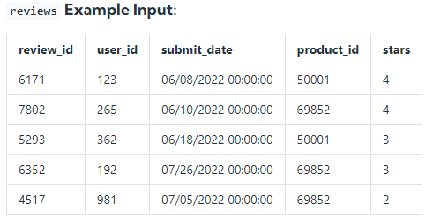
Description
Given the reviews table, write a query to retrieve the average star rating for each product, grouped by month. The output should display the month as a numerical value, product ID, and average star rating rounded to two decimal places. Sort the output first by month and then by product ID.

Slide 3
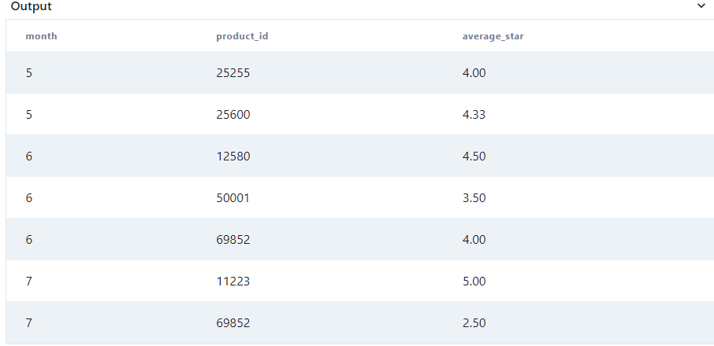
SOLUTION
SELECT EXTRACT(month from submit_date) as month,
product_id,
Round(AVG(stars),2) as average_star
FROM reviews
GROUP BY month, product_id
ORDER BY month, product_id

Slide 4
THANKS…

